Slide 1
CS 168 Designing a Network
Fall 2015
Scott Shenker
http://inst.eecs.berkeley.edu/~cs168/fa15/

Slide 2
Administrivia
Discussion sections start Wed., Sep 9
Reading assignments up for this week
This week: basics, philosophy, principles,…
Next week: routing!
Very full lecture today (100 slides!)

Slide 3
Today
What do today’s access networks look like?
Just for context
How would you build the rest of a network?
Keys are efficiency and reliability
Packet dynamics
Delays, queues, and all that….

Slide 4
Remember our Internet Diagram
link
end-system
switch

Slide 5
ISP Technologies
ISPs have very similar backbone technologies to connect regions and connect to each other
But they differ substantially in their “last mile”
The “access technology” that reaches the consumer

Slide 6
Some ISPs are phone companies
phone company

Slide 7
Telephony Access Technology
phone company

Slide 8
Last Mile (logically)
home PC
switch

Slide 9
Last Mile (in reality)
central office
DSL modem
DSLAM
phone line
...
home PC
switch
telephone
telephone network

Slide 10
Digital Subscriber Line (DSL)
Twisted pair copper
3 separate channels
Downstream data channel
Upstream data channel
2-way phone channel

Slide 11
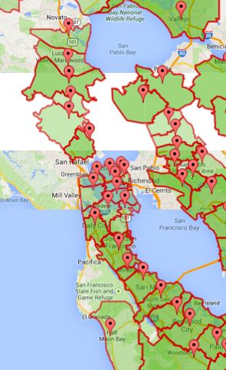
AT&T Central Offices in Bay Area

Slide 12
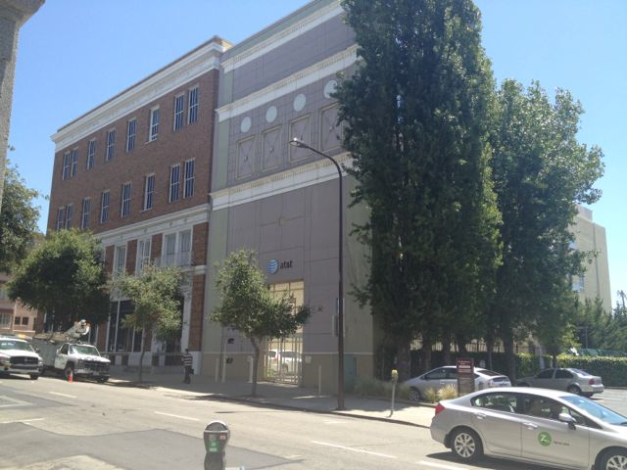
AT&T Central Office in Berkeley

Slide 13
Cable Access Technology
cable head end
cable modem
CMTS
copper
fiber
...
home PC
switch

Slide 14
Many households share access
cable head end
CMTS
fiber
switch

Slide 15
Cable
Coaxial copper & fiber
Shared broadcast medium
Why?

Slide 16
Enterprise Access Technology
Ethernet cable
...
workstation
“local” switch
“aggregate” switch

Slide 17
Ethernet
Twisted pair copper
1 Gbps, 10 Gbps, 100Gbps (each direction)

Slide 18
Other access technologies
Cellular (smart phones)
Satellite (remote areas)
Fiber to the Home (home)

Slide 19
Access Technologies
From an architectural perspective…
Access technologies are a boring detail
Logical equivalent of a wire to the first-hop switch
From an infrastructure perspective…
That’s where all the money goes
Deployment, maintenance, speed limitations, etc.
We won’t discuss access networks any more
But this is what keeps ISP CEOs up at night…
Routing protocols, etc., are the least of their problems..

Slide 20
What about the rest of the network?
Access technologies are specialized
What about the rest of the network?
How do you scale such a network?
Billions of endpoints!

Slide 21
What about this design?
Advantage:
Every source-destination pair has its own link
Disadvantages:
No sharing
Would require too many links O(n²)

Slide 22
What about this design?
Advantage:
Lots of sharing
Disadvantages:
Too much sharing
Per-node capacity O(1/n)
Not very resilient

Slide 23
What about this design?
Advantage:
Lots of sharing
Disadvantages:
Too much sharing
Per-node capacity O(1/n)
Not very resilient
Last two designs were used for local area nets
Bad for wide area networks

Slide 24
Requirements for network topology
Resilient to failures
Several paths between each source and destination
Enough sharing to be feasible
Number of links not too high
Provide adequate per-node capacity
Number of links not too small

Slide 25
Switched Networks
Provide reasonable and flexible compromise

Slide 26

Requires sharing of links/switches
shared link and switch resources

Slide 27
Two approaches to sharing
Reservations:
“Flows” reserve bandwidth needed in advance
Must reserve their peak bandwidth
On demand: (also known as “best effort”)
Send packets when you have them
Hope for the best….

Slide 28
Example of “Statistical Multiplexing”
Statistical multiplexing:
Combining demands to share resources efficiently
Long history in computer science
Processes on an OS
Cloud computing
…
Reservation: sharing at flow level
On-demand: sharing at packet level

Slide 29
Which is better?

Slide 30
Example: three constant sources
Total bandwidth 30Mbps
Demands: Each source needs 10Mbps
Reservation and on-demand give same result
Every source gets what they need
No wasted bandwidth
….

Slide 31
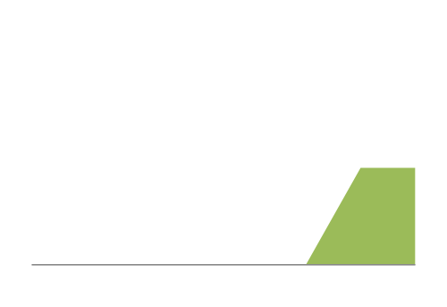
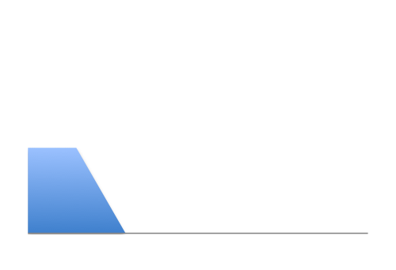
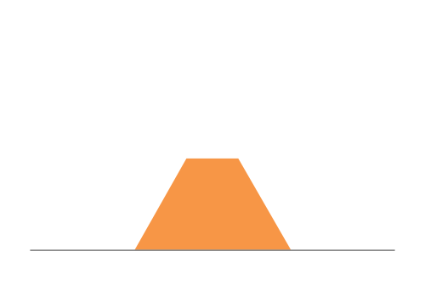
Example: Three “bursty” sources
12Mbps
Link capacity = 30Mbps
11Mbps
13Mbps
Time

Slide 32
What happens with reservations?
Option #1: allow two flows to reserve peak rate
Must turn away third flow!
12Mbps
Link capacity = 30Mbps
11Mbps
13Mbps
Time

Slide 33
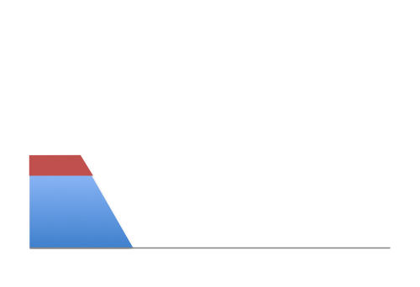
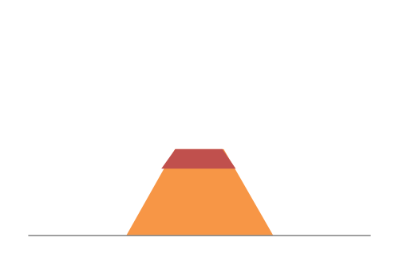
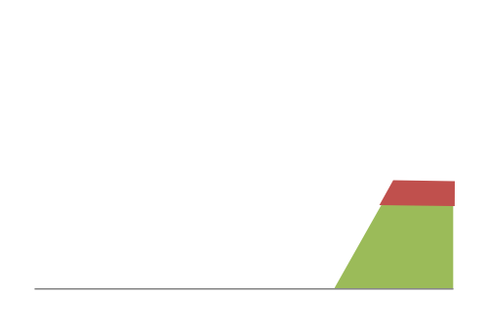
What happens with reservations?
Option #2: allow flows to reserve equal rates
Frequent overloading!
12Mbps
Link capacity = 30Mbps
11Mbps
Each source gets 10Mbps
13Mbps
Time

Slide 34
What happens with on-demand?
No overloading
Link capacity = 30Mbps
Time

Slide 35
Peak vs Average Rates
For each flow, define:
P = peak rate
A = average rate
Reservations must reserve P:
But flows only use A (on average)
Level of utilization is A/P
On-demand:
Can achieve higher utilizations
Depends on degree of sharing, burstiness of flows
Peak of aggregate approaches sum of averages

Slide 36
Smooth vs Bursty Applications
Some apps have relatively small P/A ratios
Voice might have a ratio of 3:1 or so
Data applications tend to be rather bursty
Ratios of 100 or greater are common
That’s why the phone network used reservations
And the Internet does not….
More in next lecture

Slide 37
Two approaches to sharing
Reservations
On demand
How are these implemented?

Slide 38
Two approaches to sharing
Reservations → circuit switching
On demand → packet switching
How are these implemented?

Slide 39
Circuit Switching
dst
10Mb/s?
src
✔
10Mb/s?
✔
10Mb/s?
✔
(1) src sends a reservation request for 10Mbps to dst
(2) Switches “establish a circuit”
(3) src starts sending data
(4) src sends a “teardown circuit” message

Slide 40
Circuit Switching
switch
src
dst
Reservation also establishes a “circuit” within a switch

Slide 41
Many kinds of “circuits”
Time division multiplexing
divide time in time slots
separate time slot per circuit
Frequency division multiplexing
divide frequency spectrum in frequency bands
separate frequency band per circuit
time
frequency
time

Slide 42

Timing in Circuit Switching
time

Slide 43
Timing in Circuit Switching
time

Slide 44
Timing in Circuit Switching
time

Slide 45
Timing in Circuit Switching
time

Slide 46
Timing in Circuit Switching
Circuit establishment
time

Slide 47
Timing in Circuit Switching
Data
Circuit establishment
Data transfer
time

Slide 48
Timing in Circuit Switching
Data
Circuit establishment
Data transfer
time
Circuit teardown
Notes:
Why the delays in the first pass of the establishment, but not in subsequent passes (or in teardown)?

Slide 49
Efficiency in Circuit Switching
Circuit establishment
Data transfer
time
Circuit teardown
Notes:
Why the delays in the first pass of the establishment, but not in subsequent passes (or in teardown)?

Slide 50
Efficiency in Circuit Switching
Data
time
Notes:
Why the delays in the first pass of the establishment, but not in subsequent passes (or in teardown)?

Slide 51
Circuit Switching and Failures
Circuit is established
Link Fails along path
Must establish new circuit
A
B
Circuit switching doesn’t “route around trouble”

Slide 52
Circuit Switching
Pros
Predictable performance
Simple/fast switching (once circuit established)
Cons
Complexity of circuit setup/teardown
Inefficient when traffic is bursty (or very short)
Circuit setup adds delay
Switch fails → its circuit(s) fails
Requires new circuit establishment phase

Slide 53
Packet switching
switch
dst
Each packet contains destination (dst)
Each packet treated independently

Slide 54
Packet switching
switch
dst
Each packet contains destination (dst)
Each packet treated independently
With buffers to absorb transient overloads

Slide 55
Packet Switching and Failures
Link Fails along path
Route recomputed on the fly
A
B
Packet switching “routes around trouble”

Slide 56
Packet Switching
Pros
Efficient use of network resources
Simpler to implement
Robust: can “route around trouble” (covered in routing)
Cons
Unpredictable performance
Requires buffer management and congestion control

Slide 57
Packet vs Circuit Switching
Key factors:
Resiliency: packet switching wins
Efficiency: packet switching wins (bursty sources)
Internet has chosen packet switching
Our focus for rest of course
How can we measure performance of packet switching?

Slide 58
Performance Metrics
Delay
Loss
Throughput

Slide 59
Delay
How long does it take to send a packet from its source to destination?

Slide 60
Loss
What fraction of the packets sent to a destination are dropped?

Slide 61
Throughput
At what rate is the destination receiving data from the source?

Slide 62
Today
Focus on delay
Loss and throughput will become relevant in later lectures….

Slide 63
A network link
Link bandwidth
Number of bits sent per unit time (bits/sec or bps)
Propagation delay (sometimes called latency)
Time for one bit to move through the link (seconds)
Bandwidth-Delay Product (BDP)
Number of bits “in flight” at any time (sent, not recvd)
BDP = bandwidth × propagation delay
bandwidth
delay x bandwidth
Propagation delay

Slide 64
Examples of BDP
Same city over a slow link:
bandwidth: ~100Mbps
propagation delay: ~0.1msec
BDP: 10,000bits (1.25KBytes)
Cross-country over fast link:
bandwidth: ~10Gbps
propagation delay: ~10msec
BDP: 10⁸bits (12.5MBytes)

Slide 65
Delay
Consists of four components
Transmission delay
Propagation delay
Processing delay
Queueing delay
First consider transmission, propagation delays
Then queueing delays
Ignore processing delays (tiny in most cases)
due to link properties
due to traffic mix and
switch internals

Slide 66
End-to-end delay
transmission
propagation
queuing
processing
transmission
propagation
queuing
processing
transmission
propagation

Slide 67
Transmission Delay
Q: How long does it take to push all the bits of a packet into a link?
A: Packet size / Transmission rate of the link
Example: Packet = 1kb, Rate = 100Mbps
1000 bits / 100 Mbits per sec = 10⁻⁵ sec = 10μsec

Slide 68
Propagation Delay
Q: How long does it take to move one bit from one end of a link to the other?
A: Link length / Propagation speed of link
Propagation speed ~ some fraction of speed of light
Example: Length = 30 kilometers
30 kilometers/3x10⁸ meters per sec = 10⁻⁴ sec = 10msec

Slide 69
Now ask a more practical question
Q: How long does it take for a packet to travel from A to B?
A: The delay combines both transmission and propagation delays
Perhaps also queueing, but ignore those for now

Slide 70
Example: 100B packet from A to B
A
B
1Mbps, 1ms
100Byte packet
time=0
Time to transmit one bit = 1/10⁶s
Time when that bit reaches B = 1/10⁶+1/10³s
Time to transmit 800 bits=800x1/10⁶s
The last bit reaches B at
(800x1/10⁶)+1/10³s
= 1.8ms
Time

Slide 71
Example: 100B packet from A to B
1GB file in 100B packets
1Gbps, 1ms?
A
B
1Mbps, 1ms
100Byte packet
10⁷ x 100B packets
The last bit in the file reaches B at
(10⁷x800x1/10⁹)+1/10³s
= 8001ms
The last bit reaches B at
(800x1/10⁹)+1/10³s
= 1.0008ms
The last bit reaches B at
(800x1/10⁶)+1/10³s
= 1.8ms
Time

Slide 72
Three cases with 1msec prop. delay
1GB file, 1Gbps link: transmission time dominant
100B packet, 1Gbps link: propagation delay dominant
100B packet, 1Mbps link: transmission ~ propagation
Design differs based on which dominates
But in the Internet, can’t know in advance!

Slide 73
Technology Trends
Propagation delay?
No change
Transmission delay?
Getting smaller!
Queueing delay?
Usually smaller
How does this affect applications?
CDNs work very hard to move data near clients
Reduces backbone bandwidth requirements
But also decreases latency
Google: time is money!

Slide 74
What Trend Did I Leave Out?
The dominance of video
Very high fraction of traffic is video
Files getting larger
But also many, many small flows…

Slide 75
The “pipe” view
A
B
100Byte packet
1Mbps, 10ms
pkt tx time
100Byte packet
100Byte packet
BW →
time →
Time

Slide 76
The “pipe” view
1Mbps, 10ms (BDP=10,000)
BW →
time →
1Mbps, 5ms (BDP=5,000)
10Mbps, 1ms (BDP=10,000)
BW →
BW →
time →
time →

Slide 77
The “pipe” view
1Mbps, 10ms (BDP=10,000)
BW →
100b packets
time →
1Mbps, 10ms (BDP=10,000)
250b packets
BW →
time →

Slide 78


What happens here with on-demand?
Link capacity = 30Mbps
Time
What do we do under overload?
Notes:
What we discuss at end of lecture…

Slide 79
Answer
Packets temporarily buffered (queueing delays)
Or dropped (if buffer overflows)
Let’s talk about queueing for a bit…

Slide 80
Queueing delay: “pipe” view

Slide 81
Queueing delay: “pipe” view
No overload!

Slide 82
Queueing delay: “pipe” view
Queue
Transient Overload
Not a rare event!

Slide 83
Queueing delay: “pipe” view
Queue
Transient Overload
Not a rare event!

Slide 84
Queueing delay: “pipe” view
Queue
Transient Overload
Not a rare event!

Slide 85
Queueing delay: “pipe” view
Queue
Transient Overload
Not a rare event!

Slide 86
Queueing delay: “pipe” view
Queue
Transient Overload
Not a rare event!

Slide 87
Queueing delay: “pipe” view
Queue
Transient Overload
Queues absorb transient bursts but introduce queueing delay
Not a rare event!

Slide 88
Queueing delay: “pipe” view
What about persistent overload?
Will eventually drop packets (“loss”)

Slide 89
More packet animations….

Slide 90
The Lifecycle of Packets
Packet Currently
Being Transmitted
Link
Packet Buffer
Packet Arriving
at Switch
Packet
Being
Transmitted
Excess Packets
Stored in Buffer

Slide 91
The Delays of Their Lives
Transmission
Delay
Queueing
Delay
Round-Trip Time (RTT) is the time it takes
a packet to reach the destination and
the response to return to the sender
Propagation Delay is how long it takes
to reach the next switch after transmission

Slide 92
Smooth Arrivals = No Queueing Delays

Slide 93
Bursty Arrivals = Queueing Delays
There is substantial queueing delay even though link is underutilized

Slide 94
Packet Losses: Buffers Full

Slide 95
Packet Losses: Corruption

Slide 96
Queueing Delay
How long does a packet have to sit in a buffer before it is processed?
Depends on traffic pattern
Arrival rate at the queue
Nature of arriving traffic (bursty or not?)
Transmission rate of outgoing link

Slide 97
Average queuing delay
arrival rate / departure rate
1
Notes:
This plot shows the average queuing delay experienced by a packet arriving at a buffer,
as a function of this entity here, which is the arrival rate divided by the departure rate.
As this entity approaches 1 (the arrival rate approaches the departure rate),
the average delay goes to infinity.
The important thing to note about this curve is the shape.
When we approach close to this area here, the curve goes up very fast.
This means that small changes in arrival rate can have a dramatic impact on delay.
This is what happens when you are driving in a congested highway.
The smallest disturbance (like one car braking) can significantly increase your delay.
When you design a queuing system, you want it to operate far from that point.

Slide 98
Basic Queueing Terminology
Arrival process: how packets arrive
Average rate A
Peak rate P
W: average time packets wait in the queue
W for “waiting time”
L: average number of packets waiting in the queue
L for “length of queue”

Slide 99
Little’s Law (1961)
L = A x W
Compute L: count packets in queue every second
How often does a single packet get counted? W times
Compute A: count packets sent over time
Why do you care?
Easy to compute L and A, harder to compute W

Slide 100
Thursday’s lecture….
Layering, principles, the “good stuff”
Read K&R 1.4-1.8 (mostly for context)

